Slide 1

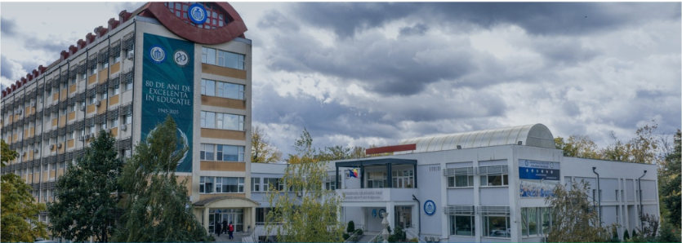
PAPER TITLE authors afilliation
UNIVERSITY OF LIFE SCIENCES ”KING MIHAI I” FROM TIMISOARA
”YOUNG PEOPLE AND MULTIDISCIPLINARY RESEARCH
IN APPLIED LIFE SCIENCES”
05-06 November 2026
Abstract: text
Introduction
Text
Material and method
Text
Results and discussions
Text
Conclusions
Text
Acknowledgement: text

